Slide 1

Hardest words to pronounce
34

Slide 2
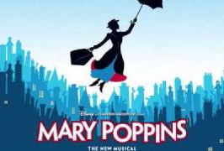
agenda
Word 1: the formation of a word from a sound
Word 2: The Mary Poppins Special
Word 3: A lung Disease
Word 4: opposition to the disestablishment of the Church of England
Word 5: The fear of Long words

Slide 3
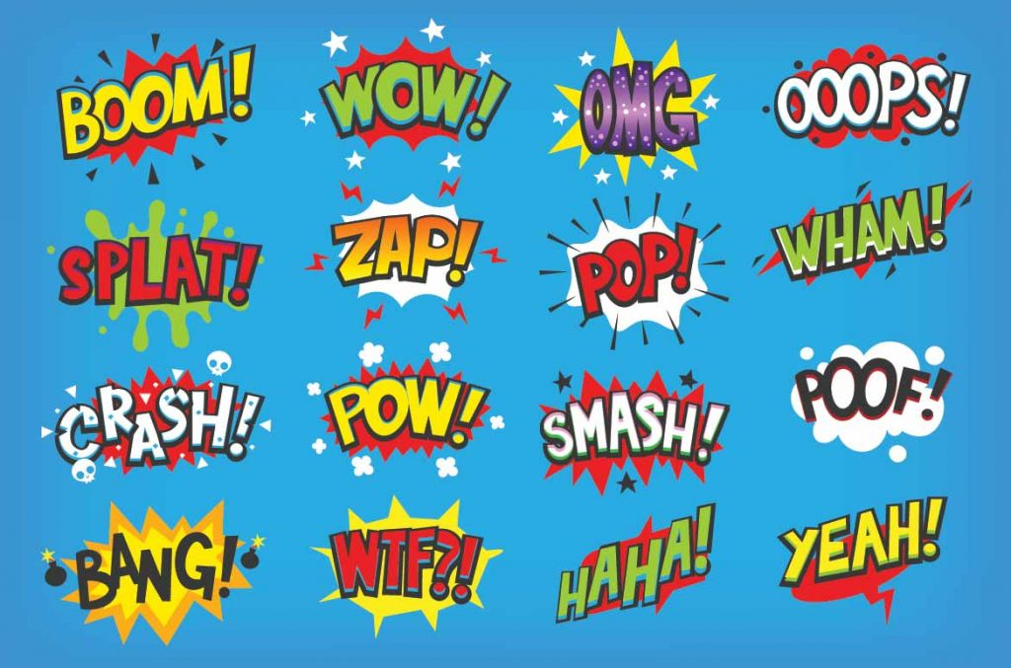
Onomatopoeia aa·nuh·maa·tuh·pee·uh
Definition: words that mimic the sounds they describe—like buzz, clang, or sizzle.
Why it’s tricky: it looks like a puzzle and sounds like poetry!
Pronunciation: ahn-uh-mah-tuh-pee-uh.
Let’s hear your favorite examples—does boom beat bang?
Notes:
“Onomatopoeia is a word that imitates the sound it describes—like buzz, crash, or sizzle. The term itself comes from Greek, combining onoma (name) and poiein (to make), meaning ‘to make a name.’ It’s one of the most fun linguistic devices in English, but saying the word itself can be a challenge!
“Let’s practice together: AHN-uh-MAH-tuh-PEE-uh. Remember, this word celebrates sound, so think of a few examples as you say it—like bam, woof, or clang!”

Slide 4
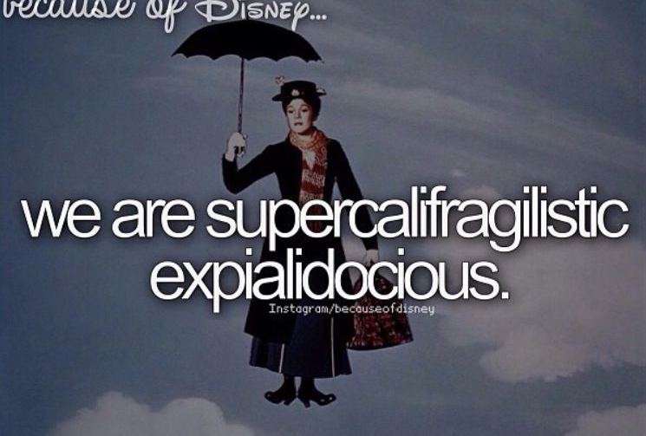
Supercalifragilisticexpialidocious soo-per-kal-i-frad-jih-lis-tik-ek-spee-al-i-doe-shus
Definition: A whimsical word meaning extraordinarily fantastic or delightful.
Why it’s tricky: this term twists and turns like a roller coaster of syllables.
Say it together: soo-per-kal-uh-fraj-uh-lis-tik-eks-pee-al-uh-doh-shus!
Fun fact: it’s the ultimate verbal victory for mary poppins fans!
Notes:
“Next up is the whimsical and wonderful Supercalifragilisticexpialidocious! While not a ‘real’ word in the strictest sense, it was popularized by the 1964 Disney film Mary Poppins. It’s a playful term meant to describe something extraordinarily fantastic or delightful.
“Ready to give it a try? SOO-per-kal-uh-FRAJ-uh-lis-tik-eks-pee-al-uh-DOH-shus. Fun fact: The songwriters of Mary Poppins claimed they made it up, combining Latin and Greek roots with pure imagination!”

Slide 5

Pneumonoultramicroscopicsilicovolcanoconiosis new-muh-noh-ul-truh-my-kroh-skop-ik-sil-i-ko-vol-kay-no-ko-nee-oh-sis
Definition: A 45-letter medical term for a lung disease caused by inhaling fine silica dust.
Why it’s tough: it’s longer than a lunch break and sneaks in scientific syllables!
Pronounce it with me: noo-muh-noh-ul-truh-my-kro-skop-ik-sil-i-ko-vol-kay-noh-koh-nee-oh-sis.
Take a deep breath—this tongue-twister might leave you winded!
Notes:
“Our first word is a lungful—literally and figuratively! Pneumonoultramicroscopicsilicovolcanoconiosis is a 45-letter medical term that refers to a lung disease caused by inhaling very fine silica particles, typically from volcanic dust. This word is recognized as the longest in major English dictionaries and is a favorite among word nerds.
“Let’s break it down: NOO-muh-noh-ul-truh-my-kro-skop-ik-sil-i-ko-vol-kay-noh-koh-nee-OH-sis. Take it one syllable at a time, and don’t forget to breathe—ironic, given its meaning!”

Slide 6

Antidisestablishmentarianism
AN · TI · DIS · ES · TAB · LISH · MENT · AR · I · AN · IS · M
Definition: opposition to disestablishing the church of england—a political term from the 19th century.
Why it’s tricky: it’s a mouthful of meaning and history.
Try it out: an-tee-dis-uh-stab-lish-men-tair-ee-uh-niz-uhm.
Say it to sound smart at your next debate!
Notes:
“Antidisestablishmentarianism was born in the 19th century during a heated debate in Britain about the separation of church and state. This word refers to the opposition to disestablishing the Church of England. In simpler terms, it’s a political term describing resistance to change in the established order.
“Here’s how it rolls off the tongue: AN-tee-dis-uh-stab-lish-men-TAIR-ee-uh-niz-uhm. While it may no longer be a hot topic, its length makes it legendary in the world of long English words.”

Slide 7
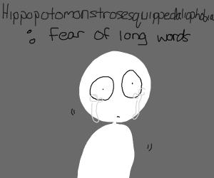
Hippopotomonstrosesquippedaliophobia hi·puh·paa·tuh·muhn·strow·suh·skwipt·a·lee·ow·fow·bee·uh
Definition: The ironic fear of long words.
Why it’s funny: It’s longer than the phobia it describes!
Say it slowly: HIP-uh-pah-toe-mon-stroh-ses-kwip-ed-ahl-ee-oh-FOH-bee-uh.
Overcoming this word might just cure the condition!
Notes:
“This next word is as ironic as it is lengthy. Hippopotomonstrosesquippedaliophobia describes the fear of long words. Yes, the word for fearing long words is… a very long word!
“It’s a humorous invention, combining hippopotamus (big), monstrous (scary), and sesquipedalian (related to long words). Say it with me: HIP-uh-pah-toe-mon-stroh-ses-kwip-ed-ahl-ee-oh-FOH-bee-uh. Conquering this tongue twister is the first step to curing the fear!”

Slide 8
Summary
In this tricky tour of tongue-twisting terms, we tackled Onomatopoeia, the sound-making superstar.
Skipped to Supercalifragilisticexpialidocious, a spectacularly silly syllable song.
We then looked at Pneumonoultramicroscopicsilicovolcanoconiosis, the lungful of a lung disease.
We dared to face Antidisestablishmentarianism, a politically potent pile of letters
Wrapped with Hippopotomonstrosesquippedaliophobia, the fear of fantastically lengthy words.
Practicing these puzzling pronunciations turns twisted terms into triumphs!

Slide 9
Citations
1. “Pneumonoultramicroscopicsilicovolcanoconiosis: Definition, Meaning, and Origin,” Oxford English Dictionary. [Online]. Available: https://www.oed.com. [Accessed: 23-Jan-2025].
2. R. M. Sherman and R. B. Sherman, Mary Poppins Soundtrack, Walt Disney Records, 1964.
3. “Onomatopoeia,” Merriam-Webster Dictionary. [Online]. Available: https://www.merriam-webster.com. [Accessed: 23-Jan-2025].
4. “Hippopotomonstrosesquippedaliophobia: The Fear of Long Words,” Psychology Today. [Online]. Available: https://www.psychologytoday.com. [Accessed: 23-Jan-2025].
5. “Antidisestablishmentarianism: Origins and Usage,” Encyclopedia Britannica. [Online]. Available: https://www.britannica.com. [Accessed: 23-Jan-2025].

Slide 10
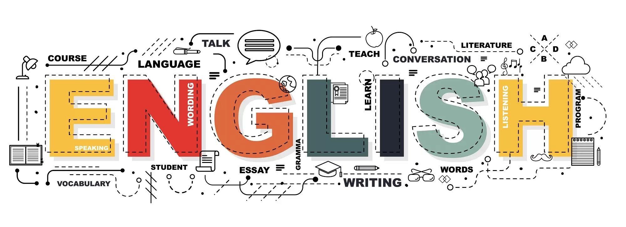

Thank you
Jamin | Ramil | NIyah | SEheR | Qianxiang |

